Slide 1

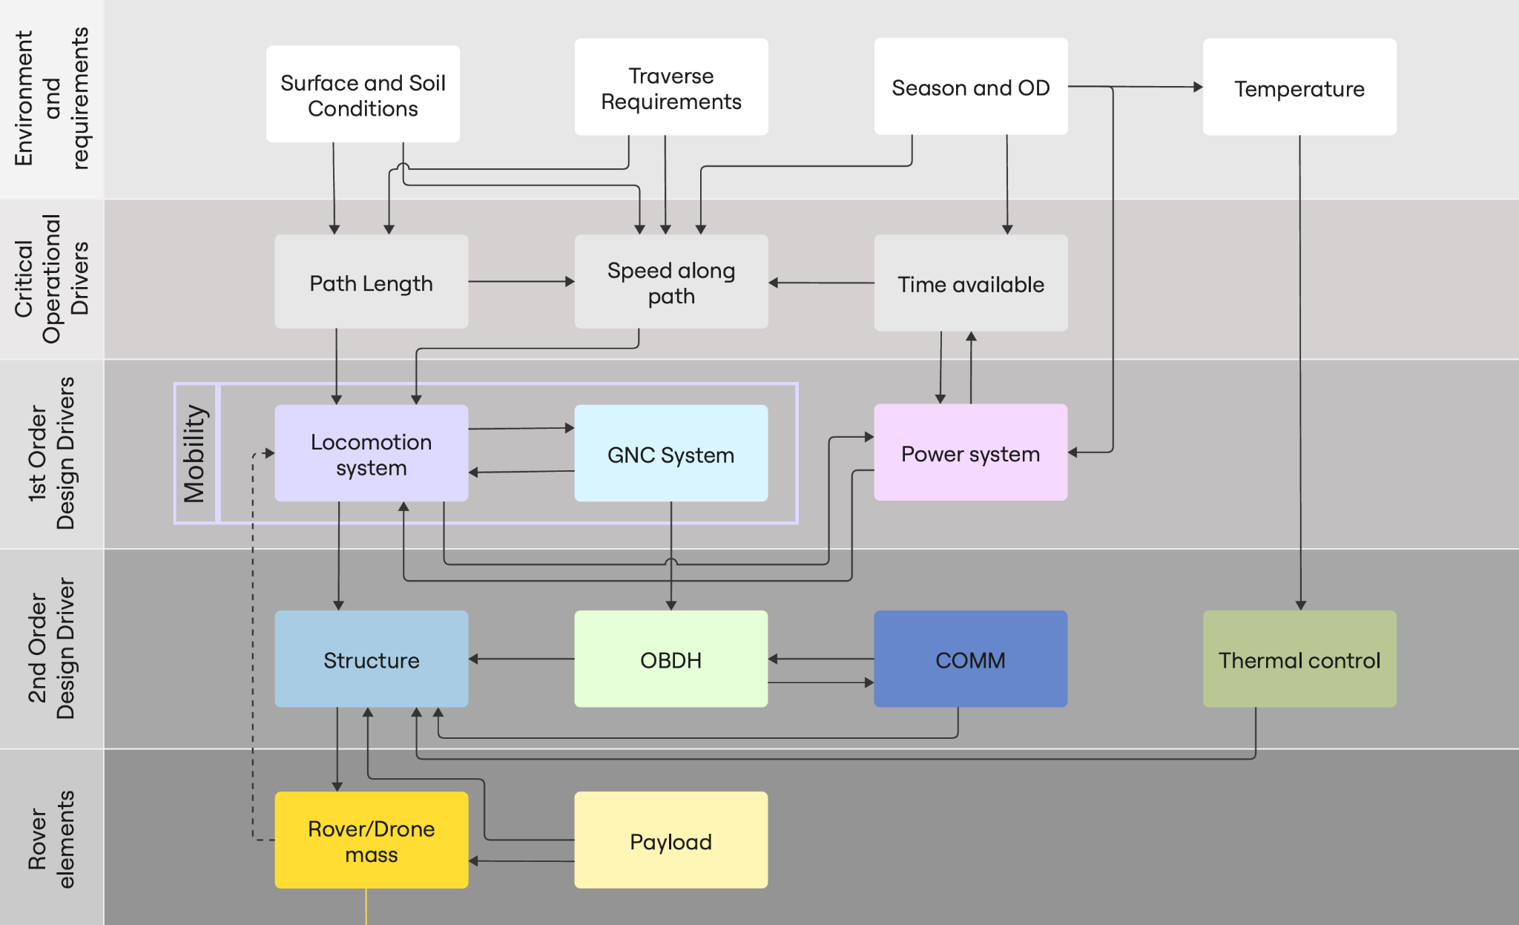
SYSTEMS ARCHITECTURE
DESIGN DRIVERS, DEPENDENCIES AND ULTIMATE IMPACT ON ROVER / DRONE MASS
TP UMBRELLA - MSS26

Slide 2
SYSTEMS ARCHITECTURE
FUNCTIONAL SYSTEM ARCHITECTURE
Command GPU
NAVIGATION
Mobility Manager
OBC
NAV CAM
AbsLoc
Reference attitude
NAV MAP
Terrain evaluation
Perception
Preparation
Mobility equipment interface
NAV CAM
IMU acc
RelLOC
Mobility equipment interface
Wheel Odo
NAV MAP, pose and target
IMU gyro
Estimator
PATH PLANNING
Loc CAM
Position and attitude
Path
VisLOC
Locomotion
TRAVERSE MONITORING
Position, heading,path sequence
Coarse tilt
Trajectory control
GenACK, GenPT, Stop
Slippage
Locomotion maneuver control
Pan and Tilt
Safe position
Maneuver motor command
Actuator drive electronics
M
Mobility equipment interface
ADE Manager
BC
Power Distribution Unit (PDU)
Corrected maneuver motor command
M
TP UMBRELLA - MSS26
BEMA

Slide 3

SYSTEMS ARCHITECTURE - ROVER
OBDH SYSTEM ARCHITECTURE
ROVER POWER ARCHITECTURE
Power Distribution Unit (PDU)
Triple-Junction GAS Solar Array
15-40V (variable) 28 nominal)
High Capacity Li-ion Battery Bank (8s)
GPU
ADCS DATA (IMU)
OBC
Spectrometer
12V
3.3V
Environmental sensors
GEOPHONES / PASS
THP DATA LOOP
EPS DATA
Nav Cam
5V
Power Distribution Unit (PDU)
5V
Geophones + PASS
COMMANDS
Micro-Actuators
24V
3.3V, 5V
OBC / AI Accelerator
I2C/SPI
STORAGE
UPLINK/DOWNLINK : ETHERNET/UART
INTERNAL : SPI
RF MODEM
RF MODEM
Locomotion Motors
24V
5V
GPU/communication module
ANTENNA
ANTENNA
PDU Logic & Telemetry
Voltage, current, temp monitoring, fault reporting
TP UMBRELLA - MSS26

Slide 4

SYSTEMS ARCHITECTURE - DRONE
OBDH SYSTEM ARCHITECTURE
DRONE POWER ARCHITECTURE
Power Distribution Unit (PDU)
Triple-Junction GAS Solar Array
15-40V (variable) 166 nominal)
High Discharge Li-ion Battery Bank (4s)
GPU
ADCS DATA (IMU)
FC
LIDAR DATA
LiDAR
5-12V
THP DATA LOOP
EPS DATA
Nav Cam
5V
Power Distribution Unit (PDU)
5V
Proximity Sensors Module
COMMANDS
Micro-Actuators
24V
3.3V
FC
I2C/SPI
STORAGE
UPLINK/DOWNLINK : ETHERNET/UART
INTERNAL : SPI
RF MODEM
RF MODEM
Locomotion Motors
24V
5V
GPU
ANTENNA
ANTENNA
PDU Logic & Telemetry
Voltage, current, temp monitoring, fault reporting
TP UMBRELLA - MSS26

Slide 5
SYSTEMS ARCHITECTURE - COMMUNICATIONS
COMMS SYSTEM ARCHITECTURE - ROVER
COMMS SYSTEM ARCHITECTURE - DRONE
Multispectral Camera Controller
Drone Flight Computer / Avionics
Multispectral detector head
Rover Comms & Data Handling (C&DH) Unit
PCIe
GPU / AI Accelerator
SpaceWire / Ethernet
PCIe
GPU / AI Accelerator
Flight Control CPU
I2C / SPI
CPU / OBC
I2C
I2C / SPI
Local FPGA/ISP
I2C / SPI
Navigation Stack (IMU, altimeter, GNSS)
Mass Memory
CSI-2 + SPI
Drone Payloads
Raman Spectrometer Controller
UART / PPS INPUT
SPI
Local Mass Memory
Time Sync & Clock
I2C / SPI
SpaceWire / Ethernet
TM/TC Router (CCSDS / IP)
UART+ETHERNET
TM/TC & Payload Router
Laser + spectrograph + detector
Coaxial (RF)
LiDAR Unit
UART / SPI / Ethernet
Camera
PASS / Geophone DAQ Module
UART
SpaceWire / Ethernet
Local FPGA/ISP
Rover Deep Space Link Subsystem
Rover Drone Local Link Subsystem
Drone Local Radio Subsystem
Rover Local Link Antenna (Omni/Patch)
Geophone analog front-end + ADC Local DSP / FPGA
X/Ka-band Transponder
Local Link Radio Modem (UHF / VHF / ISM)
Radio Modem (UHF/VHF/900 MHz)
RF UHF/VHF
Drone antenna (Patch/Monopole)
Coaxial RF
Coaxial RF
UART
SSPA
Diplexer / RF switching network
RF Front-End
RF Front-End
Coaxial RF
RF X/Ka-band
Air Interface (ISM Band 900 MHz) Bi-directional wireless link for commands, telemetry and science data.
High-Gain Antenna (HGA)
RF Deep Space Link(X / Ka band)
Low Gain Antenna (LGA)
Ground / Orbiter
TP UMBRELLA - MSS26
Notes:
Tier 1: Local Surface Communication (Proximity Link)
◦ Definition: Short-range communication between surface assets, specifically between the Rover and the Drone (Helicopter).
Tier 2: Surface-to-Orbit Relay (Regional Link)
◦ Definition: Medium-to-long-range communication from surface assets (Rover or independent Helicopter) to an orbiting asset (Mars Orbiter).
Tier 3 : Deep Space Network (Direct-to-Earth)
◦ Definition: Long-haul high-bandwidth communication directly between the Martian surface and Earth.

Slide 6
System architecture
Command GPU
Mobility Manager
OBC
NAV CAM
AbsLoc
Reference attitude
NAV MAP
Terrain evaluation
Perception
Preparation
Mobility equipment interface
NAV CAM
IMU acc
Mobility equipment interface
Wheel Odo
NAV MAP, pose and target
IMU gyro
Estimator
PATH PLANNING
Loc CAM
Position and attitude
Path
VisLOC
Locomotion
Position, heading,path sequence
Coarse tilt
Trajectory control
GenACK, GenPT, Stop
Slippage
Locomotion maneuver control
Pan and Tilt
Safe position
Maneuver motor command
Actuator drive electronics
M
BC
Mobility equipment interface
ADE Manager
Corrected maneuver motor command
M
BEMA
(18 motors)

